Slide 1
Clean code and Unit tests
Karolis Grigonis
IT Academy 2022-03-08

Slide 2
Agenda
Clean code intro
Pyramid of Clean Code
Clean Code Basics
Clean Code Principles
SOLID Principles
Unit test naming
Other tips
What is unit testing?
JUnit
Annotations
Good practice
Good unit tests
Mockito
Code coverage
TDD

Slide 3
Clean code
Notes:
What do you think is clean code?

Slide 4
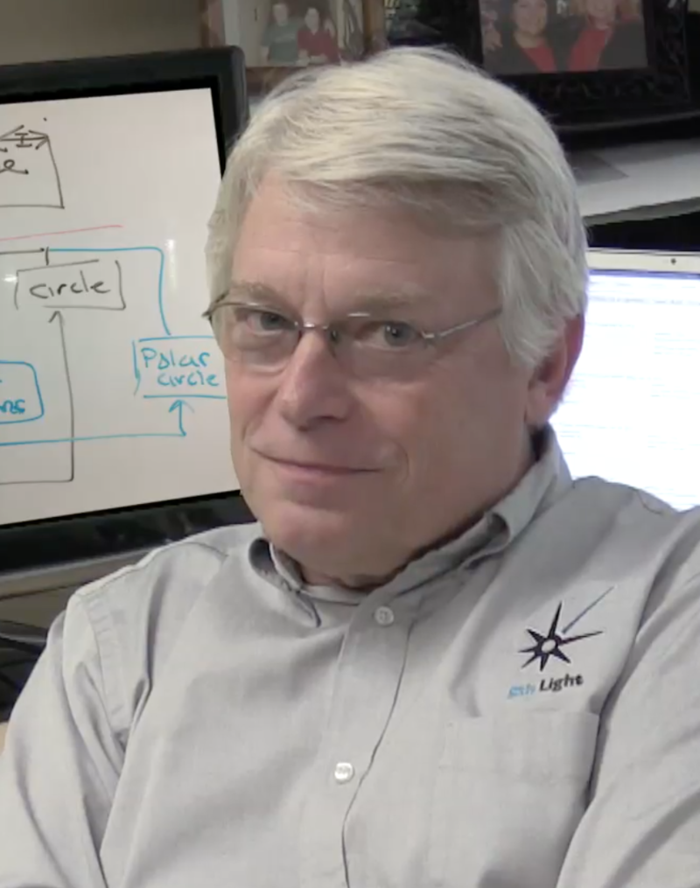

Clean code
Characteristics of a clean code:
It should be elegant
Clean code is focused
Clean code is taken care of
Runs all the tests
Contains no duplication
Notes:
Robert C. Martin a.k.a Uncle Bob. Uncle Bob Consulting.
C++/java
Agile Mainfesto
Solid principles
Clean code should be pleasing to read. Reading it should make you smile the way a well-crafted music box or well-designed car would.
Each function, each class, each module exposes a single-minded attitude that remains entirely undistracted, and unpolluted, by the surrounding details.
Someone has taken the time to keep it simple and orderly. They have paid appropriate attention to details. They have cared.

Slide 5
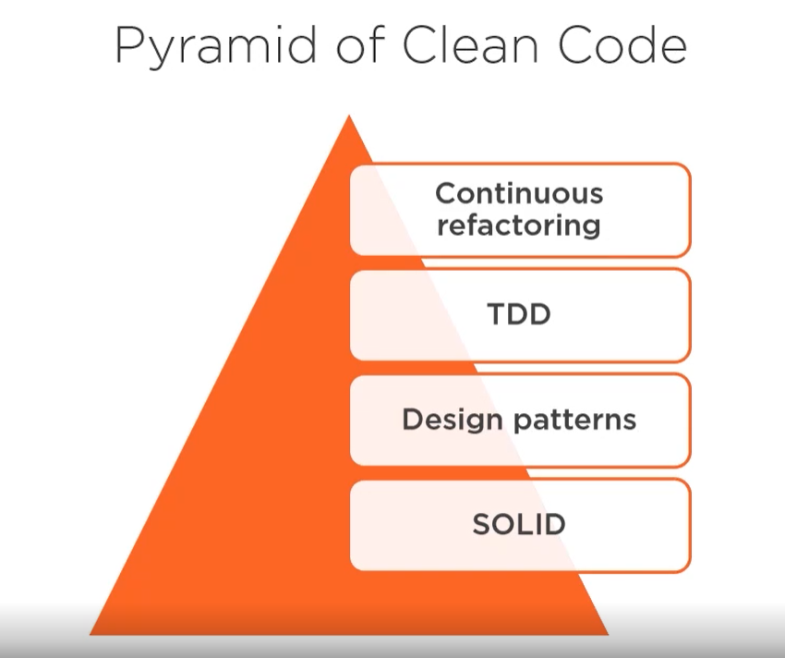
Pyramid of Clean Code

Slide 6
Clean Code Basics
Meaningful names
Method arguments
Method size
Comments
Notes:
Use intention revealing names. Choosing good names takes time but saves more than it takes. The name of a variable, method, or class, should answer all the big questions. It should tell you why it exists, what it does, and how it is used. If a name requires a comment, then the name does not reveal its intent.
Live demo

Slide 7
Clean code principles
K.I.S.S
D.R.Y
Y.A.G.N.I
Favor readability
Practice consistency

Slide 8
K.I.S.S
Keep It Simple Stupid. It states that most systems should be kept as simple as possible (but not simpler, as Einstein would have said). Unnecessary complexity should be avoided. The question to ask when you're writing code is "can this be written in a simpler way?"
Notes:
Tool application
ExcelWorker line 139 readFromBicExcel

Slide 9
D.R.Y
Don't Repeat Yourself. Closely related to K.I.S.S and the minimalist design philosophy. It states that every piece of code must have a single, unambiguous, authoritative representation within a system (codebase). Violations of D.R.Y are referred to as W.E.T: We Enjoy Typing, Write Everything Twice, Waste Everyone's Time.
Notes:
No code example just vocally explain about code duplication in this case.

Slide 10
Y.A.G.N.I
You Aren't Gonna Need It. A developer should not add functionality unless deemed necessary. Y.A.G.N.I is part of the Extreme Programming (XP) methodology, which wants to improve software quality and increase responsiveness to customer requirements. Y.A.G.N.I should be used in conjunction with continuous refactoring, unit testing, and integration.
Notes:
Talk about features that when you develop something and want top add something just in case or you want to add because you think it should be there than don’t do it.

Slide 11
Favor readability
It's not because a machine can read your code that another human can. Particularly when working with multiple people on a project, always favor readability over conciseness. There's no point in having concise code if people don't understand it.
There are many ways to make your code more readable. Two examples are placing common numbers into well-named constants (e.g. private static final int CACHE_TIME = 200;) and creating long names instead of shorter ones (e.g. userHasFormAccess over canAccess, which doesn't tell as much).

Slide 12
Practice consistency
This is arguably the overarching principle of all clean code principles. If you decide to do something a certain way, stick to it throughout the entire project. If you have no choice but to move away from your original choice, explain why in the comments.
Notes:
Your project codebase must follow a consistent pattern agreed upon all the developers in the team.

Slide 13
SOLID
Single Responsibility
Open/Closed
Liskov Substitution
Interface Segregation
Dependency Inversion
Notes:
Introduced by Uncle bob
Simply put, Martin and Feathers' design principles encourage us to create more maintainable, understandable, and flexible software. Consequently, as our applications grow in size, we can reduce their complexity and save ourselves a lot of headaches further down the road!
Benefits of SOLID
Easy to understand and reason about
Changes are fast and have a minimal risk level
Highly maintainable over long periods of time
Cost effective

Slide 14
Single Responsibility
Why should you use SRP?
It makes code easier to understand, fix and maintain
Classes are less coupled and more resilient to change
More testable design
Symptoms of not using SRP
Code is more difficult to read and reason about
Decreased quality due to testing difficulty
Side effects
High coupling
Notes:
a class should only have one responsibility. Furthermore, it should only have one reason to change.
Write printTextToConsole method in Book to violate single responsibility
BookPrinter is required to decouple printing from the book itself. So book doesn’t have two responsibilities

Slide 15
Open for Extension, Closed for Modification
OCP definition explained
Closed for modification: each new feature should not modify existing source code
Open for extension: a component should be extendable to make it behave in new ways
Why should you apply the OCP?
New features can be added easily and with minimal cost
Minimizes the risk of regression testing
Enforces decoupling by isolating changes in specific components, works along with the SRP
Notes:
By extending controller we know that our existing application won’t be affected
Adding other functions will cause code to be changed

Slide 16
Liskov Substitution
Next on our list is Liskov substitution, which is arguably the most complex of the five principles. Simply put, a parent can be replaced with any of its child instances without disrupting the behavior of our program.
Apply the LSP in a proactive way
Make sure that a derived type can substitute its base type completely
Keep base classes small and focused
Keep interfaces lean
“If it looks like a duck, quacks like a duck, but needs batteries – you probably have the wrong abstraction” – SOLID Motivational Poster
Notes:
Car interface with some methods that all cars should implement
By throwing a car without an engine into the mix, we are inherently changing the behavior of our program. This is a blatant violation of Liskov substitution and is a bit harder to fix than our previous two principles.
One possible solution would be to rework our model into interfaces that take into account the engine-less state of our Car.

Slide 17
Interface Segregation
The I in SOLID stands for interface segregation, and it simply means that larger interfaces should be split into smaller ones. By doing so, we can ensure that implementing classes only need to be concerned about the methods that are of interest to them.
Benefits of applying the ISP
Lean interfaces minimize dependencies on unused members and reduce code coupling
Code becomes more cohesive and focused
It reinforces the use of the SRP and LSP
Notes:
Going further, we could even split our BookPrinter class from our example earlier to use interface segregation in the same way. By implementing a Printer interface with a single print method, we could instantiate separate ConsoleBookPrinter and OtherMediaBookPrinter classes.

Slide 18
Dependency Inversion
The principle of dependency inversion refers to the decoupling of software modules. This way, instead of high-level modules depending on low-level modules, both will depend on abstractions.
High level module – modules which hold business logic and provide features to our application. They tell what the software should do.
Low level module – they are the “internals” of the application and tell how the software should do the various tasks.
Notes:
No use with pc without keyboard and monitor. Add StandardKeyboard and StandardMonitor as class fields.
Problem solved? Not quite. By declaring the StandardKeyboard and Monitor with the new keyword, we've tightly coupled these three classes together.
Low level modules – logging, io, data access
Draw diagrams with arrows.

Slide 19
Unit test naming
Should_ExpectedBehavior_When_StateUnderTest
Should_ThrowException_When_AgeLessThan18
When_StateUnderTest_Expect_ExpectedBehavior
When_AgeLessThan18_Expect_isAdultAsFalse
test[Feature being tested]
testIsNotAnAdultIfAgeLessThan18
Test_is_not_an_adult_if_age_less_than_18

Slide 20
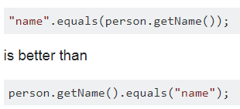

Other tips

Slide 21
Unit tests
Notes:
Has anybody heard anything about Unit tests?

Slide 22
What is unit testing?
Unit Testing is a methodology of testing source code for its fitment of use in production.
We start out writing unit tests by creating various test cases to verify the behaviors of an individual unit of source code.
Unit - Smallest testable part of an application
Unit test – code that tests smallest testable part of an application

Slide 23
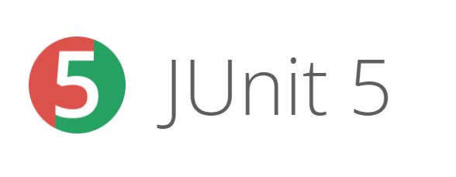
JUnit
JUnit is one of the most popular unit-testing frameworks in the Java ecosystem
Notes:
Other frameworks TestNG, Serenity, Jbehave, Selenium

Slide 24
Anotations
@DisplayName – defines a custom display name for a test class or a test method
@ExtendWith – registers custom extensions
@BeforeEach – denotes that the annotated method will be executed before each test method (previously @Before)
@AfterEach – denotes that the annotated method will be executed after each test method (previously @After)
@BeforeAll – denotes that the annotated method will be executed before all test methods in the current class (previously @BeforeClass)
@AfterAll – denotes that the annotated method will be executed after all test methods in the current class (previously @AfterClass)
@Disable – disables a test class or method (previously @Ignore)
Notes:
Hands on

Slide 25
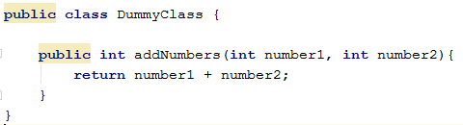
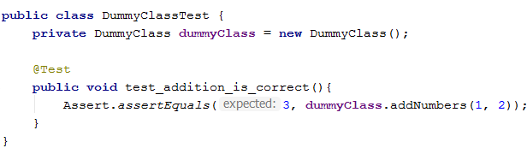

Slide 26
Good practices
Single test for each test case
Single assertion per test
Use mocking when appropriate
When fixing bugs, don‘t forget to fix unit tests
Private methods are tested via public methods
No need to test getters and setters
Notes:
always write a unit test to test a single specific scenario.

Slide 27
Good unit tests
Must cover all paths and cases
Must be repeatable
Must be independent
Test cases are independent from each other
Test cases are independent from external dependencies
Must run fast

Slide 28
Excercise
Create LettersCounter class
Add public method with two parameters: character, string
Count character occurencies in string and return that number
Write unit test for it
Notes:
Two different test cases

Slide 29
Create fake data and behaviour

Slide 30
Mockito
Methods:
Mockito.when
Mockito.verify
Annotations
@Mock
@InjectMocks
Notes:
Two different methods for inject. Hands on

Slide 31
Exercise
Create a class named Book and store number of pages in the book and book title.
Create class called Library with a list of books. Create methods to get all books, to get the number of books in the library and a method to find a book by it’s title lastly method to get the book with the highest number of pages.
Write as many unit tests as you can using mocks

Slide 32
Code Coverage

Slide 33
Code coverage
Is a measure used to describe the degree to which the source code of a program is executed during unit test code was ran.
Notes:
80%

Slide 34
Exercise
Check you first exercise code coverage
Try to modify code to increase/decrease code coverage. For example by adding a new feature to count character occurrence in a list of strings instead of a single string.

Slide 35
TDD

Slide 36
TDD – test driven development
Writing tests before code
Advantages
Programmers tend to be more productive
Rarely need to debug code via debugger/console printing
TDD can lead to more modularized/flexible code
TDD tends to prevent defects in early stages
In case of bug, it is easier to revert to previous version of code

Slide 37
TDD steps
Add a test
Run all tests to see if new test is failing
Write code to fulfill failing unit test
Run tests
Refactor code if necessary
Repeat
Notes:
Live demo

Slide 38
Exercise
Implement calculator in TDD
5 methods:
2 numbers addition
2 numbers substraction
2 numbers multiplication
2 numbers division
Find remainder after division of two numbers (modulo)
Bonus: division by zero should throw IllegalArgumentException with some message

